Slide 1
MGS 723: Geodynamics
Class 12: Heat Transfer II

Slide 2
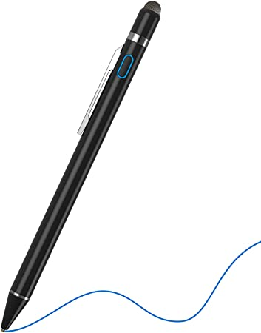
To the stylus…
Use conduction eq. to derive idealized geotherms

Slide 3
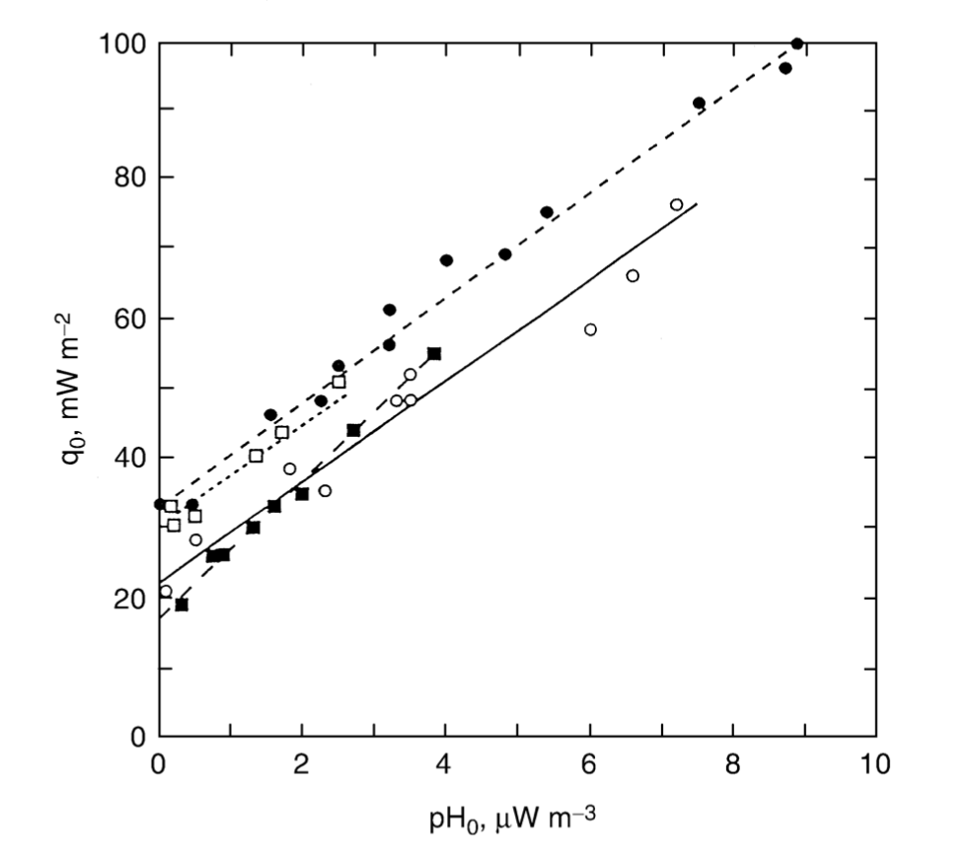
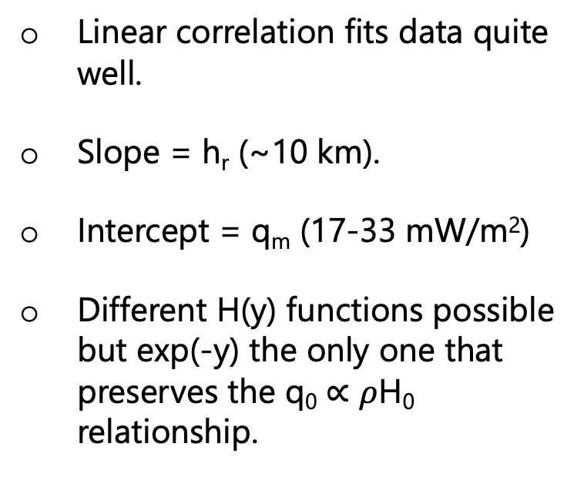
Continental geotherms
Linear correlation fits data quite well.
Slope = h_{r} (~10 km).
Intercept = q_{m} (17-33 mW/m²)
Different H(y) functions possible but exp(-y) the only one that preserves the q₀ $∝$ $ρ$H₀ relationship.
Solid squares = Sierra Nevada; solid circles = Eastern US; open circles = Norway and Sweden; open squares = Canadian Shield
Figure 4-11: T&S

Slide 4
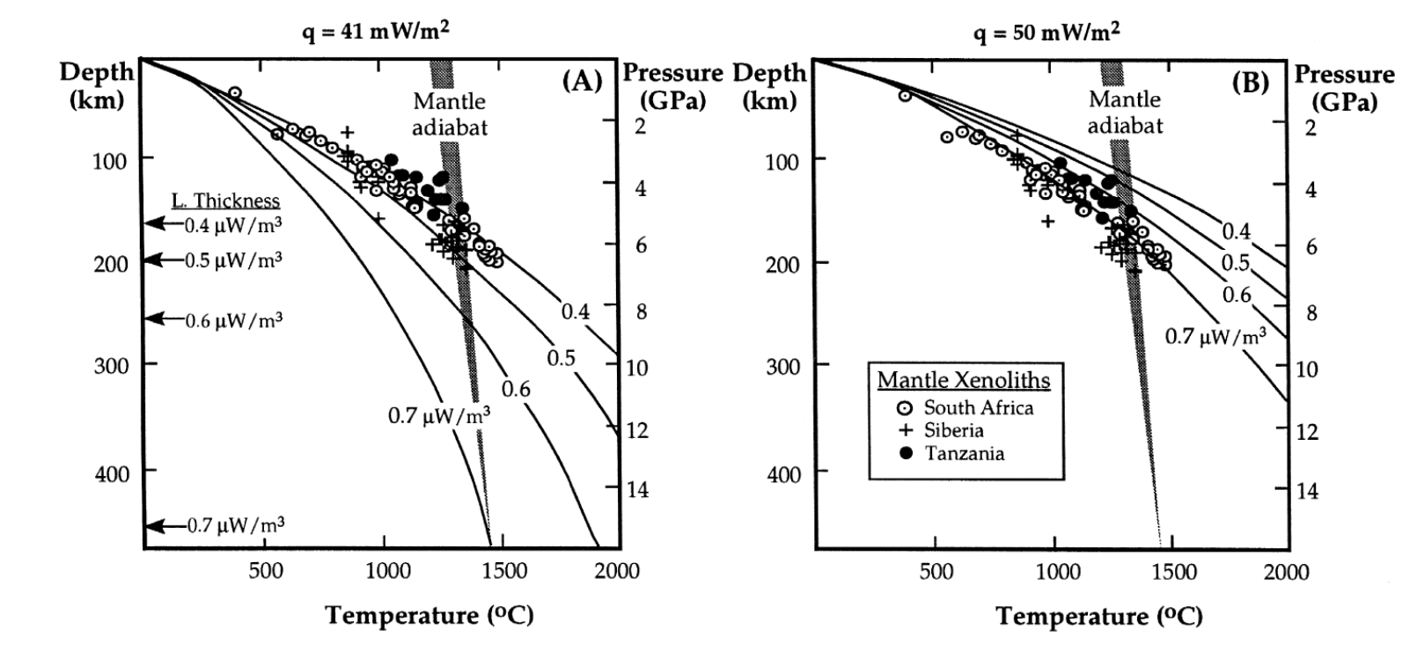
Continental geotherms
Notes:
Dunite is olivine-rich peridotite

Slide 5
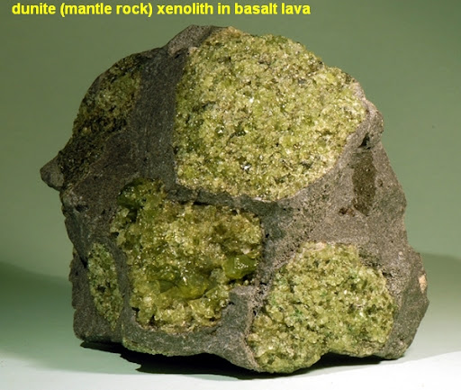
Continental geotherms
Notes:
Dunite is olivine-rich peridotite

Slide 6
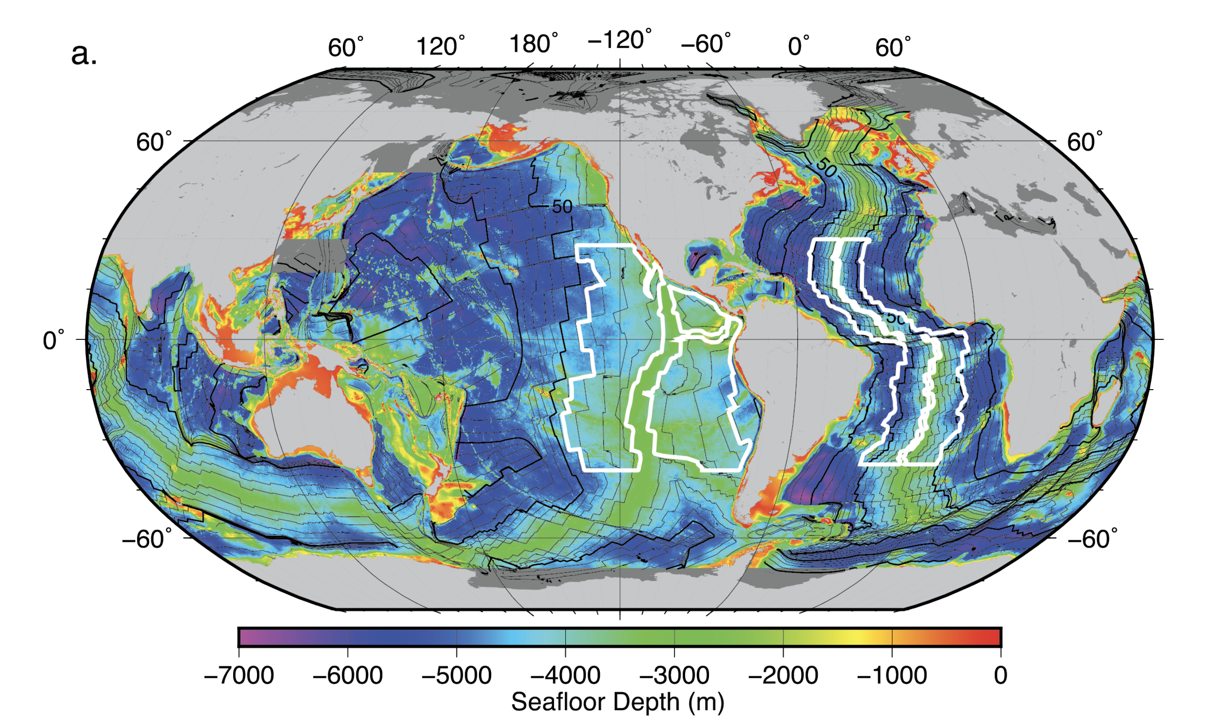
Next: Cooling of oceanic plates
C.E. Watkins, 2016

Slide 7
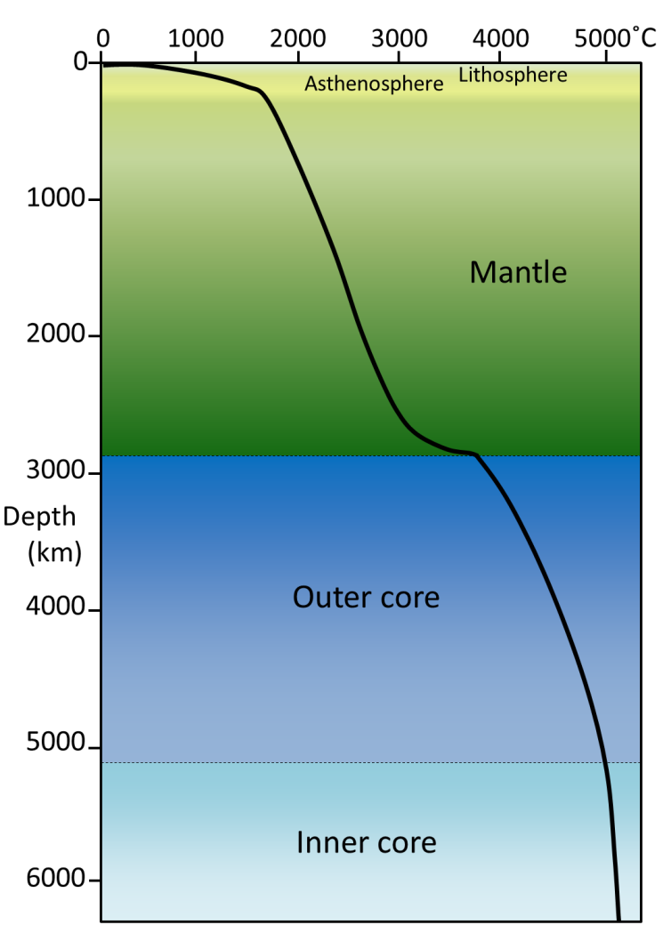
Oceanic plates are the outer thermal boundary layer

Slide 8
Oceanic plates are the outer thermal boundary layer
TBL₁
conduction
convection
TBL₂
conduction
Thermal boundary layer (TBL) = a region with very high temperature gradients that is dominated by conductive heat transfer.
On Earth: i) lithospheric plates, and ii) core-mantle boundary

Slide 9
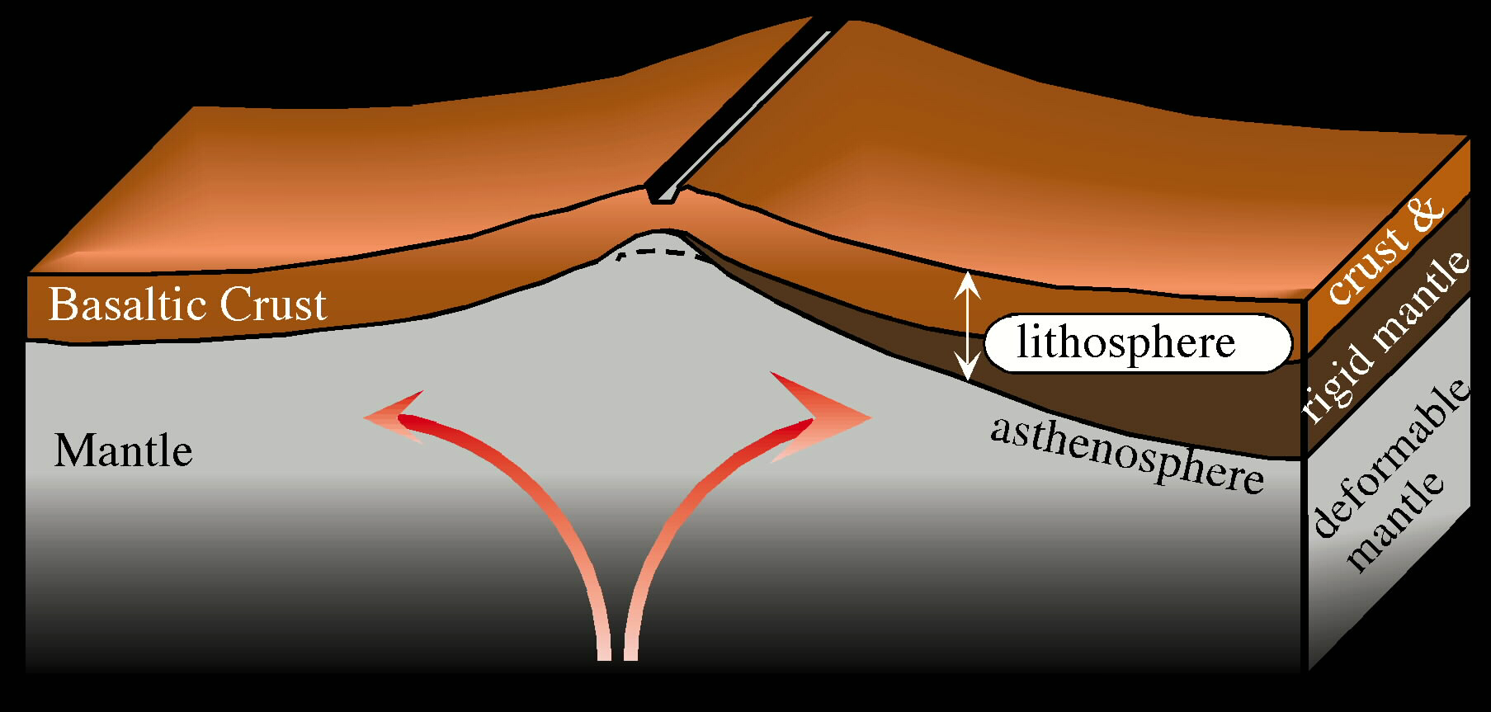
Oceanic plates form via the cooling of mantle
Composition
Thermal and mechanical structure
1000°C
~1300°C

Slide 10
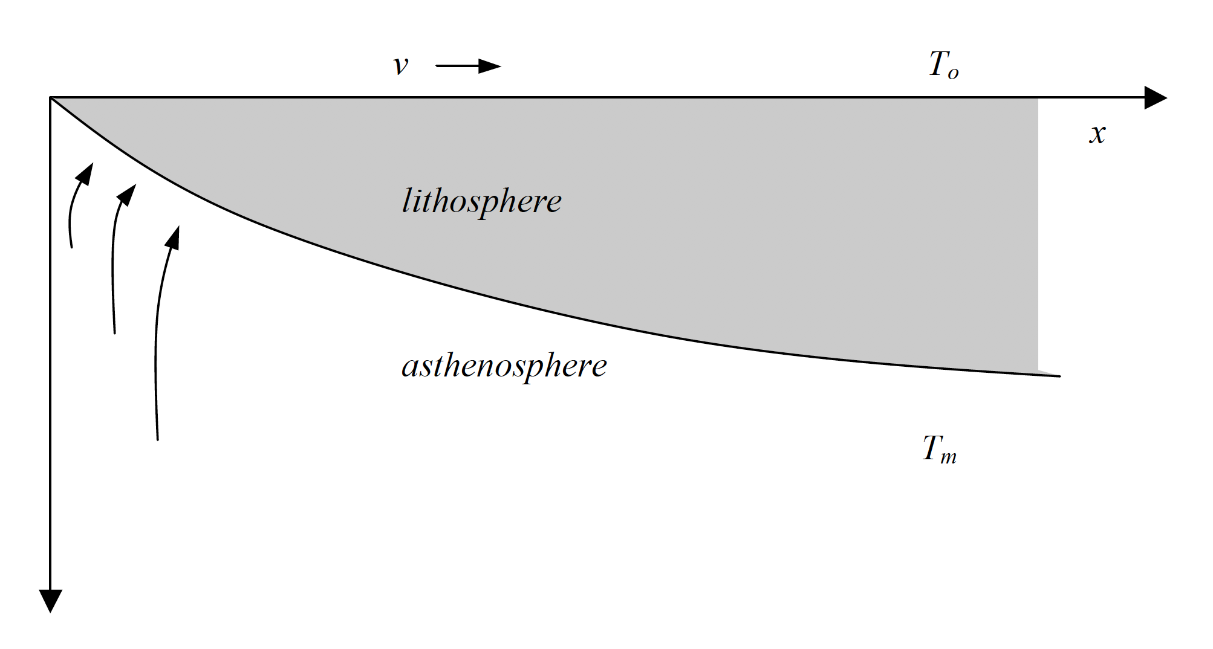
Oceanic plate formation/cooling: The basic model
“Halfspace cooling”
ridge axis
David Sandwell @ SIO, 2001

Slide 11
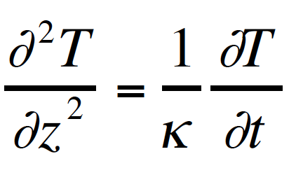
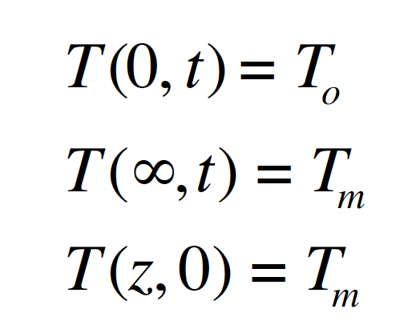
Oceanic plate formation/cooling: The basic model
“Halfspace cooling”
ridge axis
Subject to:
Goal Solve:
David Sandwell @ SIO, 2001

Slide 12
To the stylus…
To: Derive the half-space cooling solution to time-dependent conduction

Slide 13
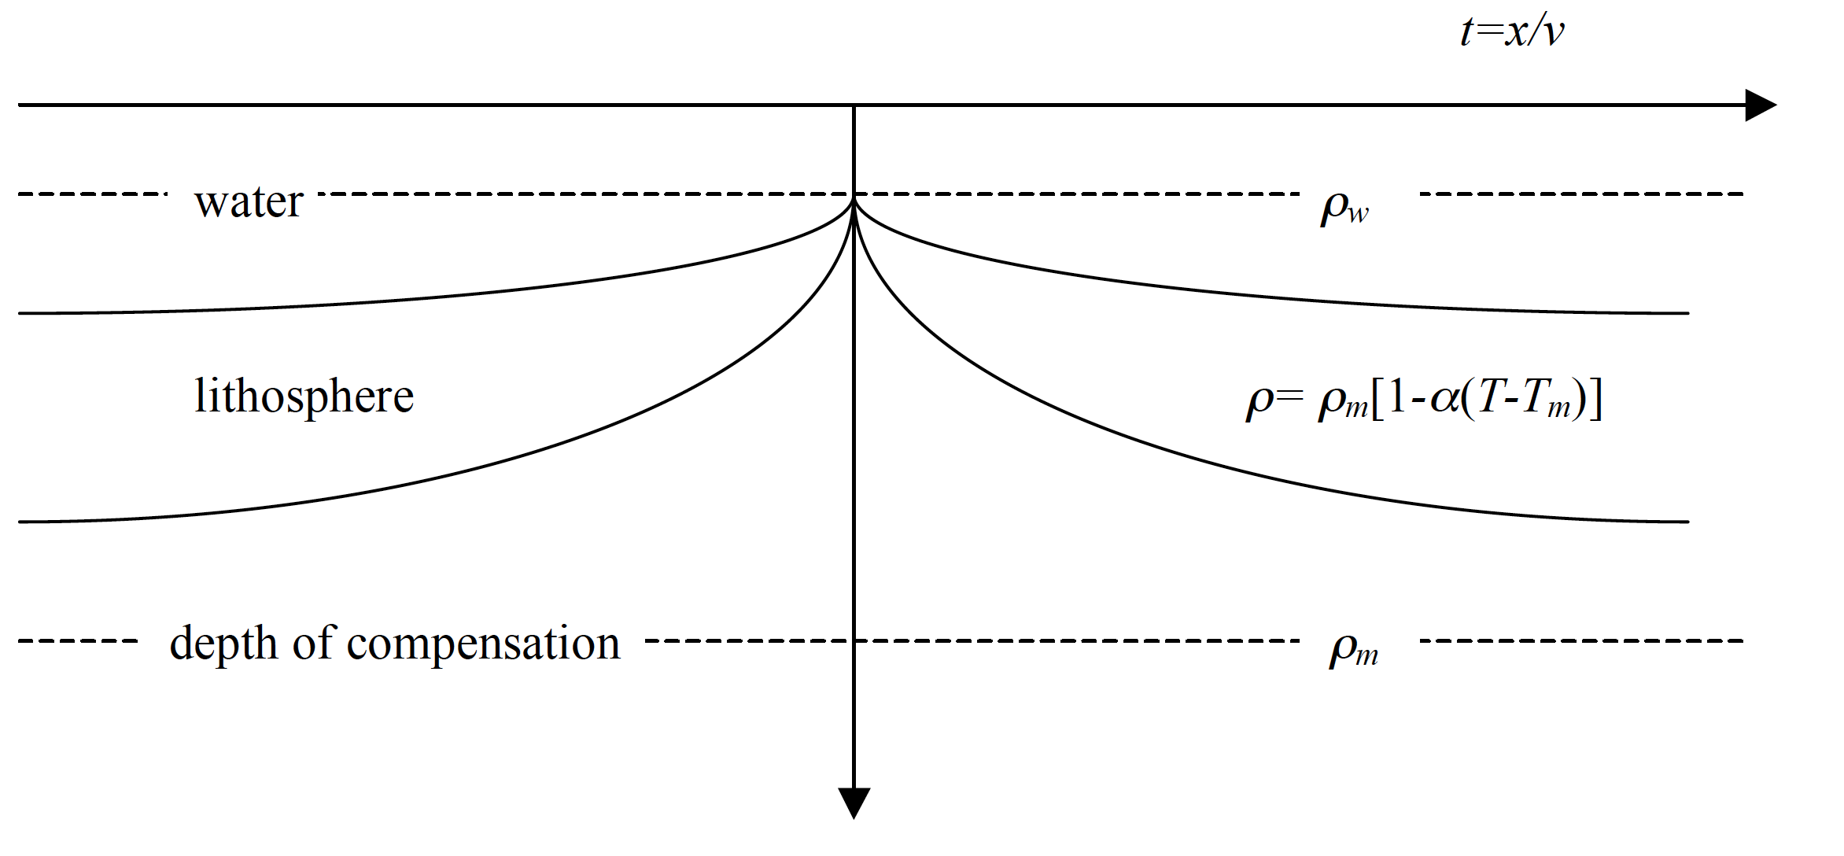
Bathymetry prediction
Can assume isostatic equilibrium and use temperature distribution (and hence density distribution) to calculate bathymetry.

Slide 14






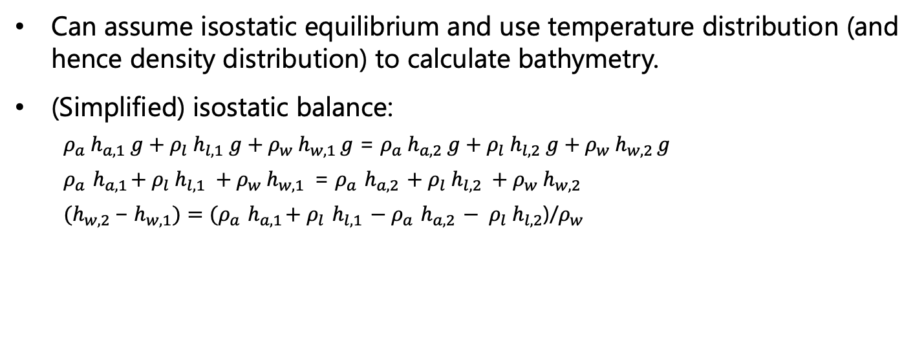


Bathymetry prediction
$$2$$
$$1$$
$$hw$$
$$ρ_{w}$$
$$hl$$
$$ρ_{l}$$
$$ha$$
$$ρ_{a}$$
Can assume isostatic equilibrium and use temperature distribution (and hence density distribution) to calculate bathymetry.
(Simplified) isostatic balance:
$ρ_{a}{ h}_{a,1} g+$ $ρ_{l}{ h}_{l,1} g$ ${+ ρ}_{w}{ h}_{w,1 }g$ = $ρ_{a}{ h}_{a,2} g+$ $ρ_{l}{ h}_{l,2} g$ $+{ ρ}_{w}{ h}_{w,2 }g$
$ρ_{a}{ h}_{a,1}+$ $ρ_{l}{ h}_{l,1}$ ${+ ρ}_{w}{ h}_{w,1 }$ = $ρ_{a}{ h}_{a,2} +$ $ρ_{l}{ h}_{l,2}$ $+{ ρ}_{w}{ h}_{w,2 }$
${{(h}_{w,2 }\text{−} h_{w,1})=(ρ}_{a}{ h}_{a,1}+$ $ρ_{l}{ h}_{l,1} −ρ_{a}{ h}_{a,2} − ρ_{l}{ h}_{l,2}$)/$ρ_{w}$

Slide 15
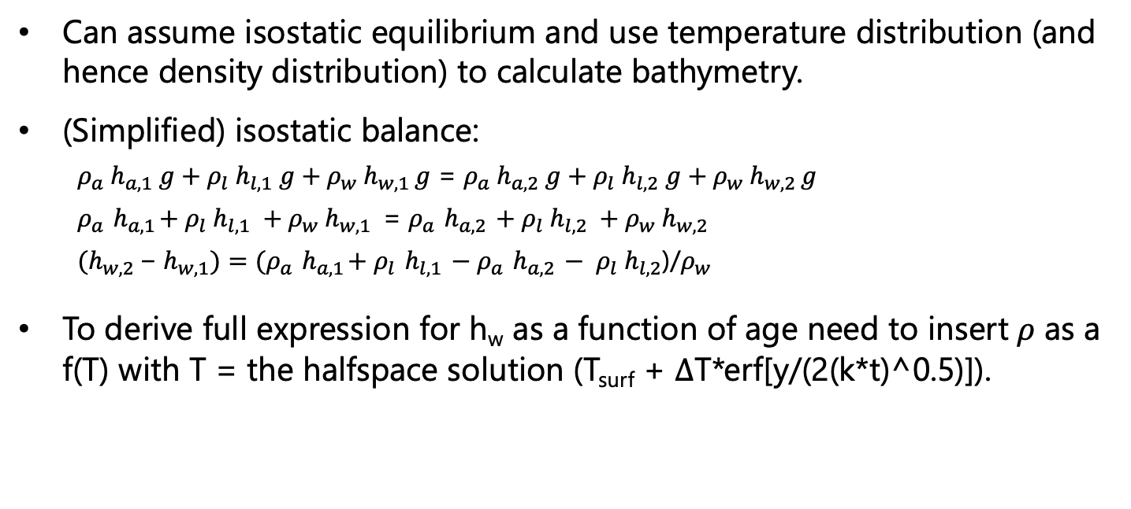
Bathymetry prediction
$$2$$
$$1$$
$$hw$$
$$ρ_{w}$$
$$hl$$
$$ρ_{l}$$
$$ha$$
$$ρ_{a}$$
Can assume isostatic equilibrium and use temperature distribution (and hence density distribution) to calculate bathymetry.
(Simplified) isostatic balance:
$ρ_{a}{ h}_{a,1} g+$ $ρ_{l}{ h}_{l,1} g$ ${+ ρ}_{w}{ h}_{w,1 }g$ = $ρ_{a}{ h}_{a,2} g+$ $ρ_{l}{ h}_{l,2} g$ $+{ ρ}_{w}{ h}_{w,2 }g$
$ρ_{a}{ h}_{a,1}+$ $ρ_{l}{ h}_{l,1}$ ${+ ρ}_{w}{ h}_{w,1 }$ = $ρ_{a}{ h}_{a,2} +$ $ρ_{l}{ h}_{l,2}$ $+{ ρ}_{w}{ h}_{w,2 }$
${{(h}_{w,2 }\text{−} h_{w,1})=(ρ}_{a}{ h}_{a,1}+$ $ρ_{l}{ h}_{l,1} −ρ_{a}{ h}_{a,2} − ρ_{l}{ h}_{l,2}$)/$ρ_{w}$
To derive full expression for h_{w} as a function of age need to insert $ρ$ as a f(T) with T = the halfspace solution (T_{surf} + $∆$T*erf[y/(2(k*t)^0.5)]).

Slide 16
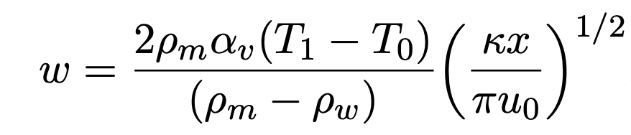

Half-space cooling solutions
Results in the following solution for water depth (bathymetry);
bathymetry $∝\sqrt{distance}$
T&S: Sect. 4-23

Slide 17
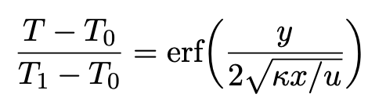
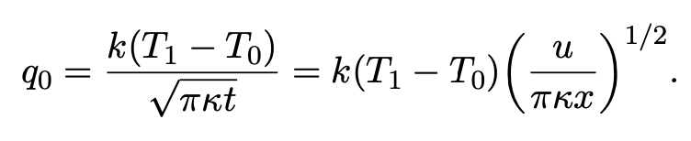
Half-space cooling solutions
Results in the following solution for water depth (bathymetry);
Solutions previously derived (for T and q₀ ):

Slide 18
Half-space cooling solutions
Results in the following solution for water depth (bathymetry);
Solutions previously derived (for T and q₀ ):
Do they match observations?

Slide 19
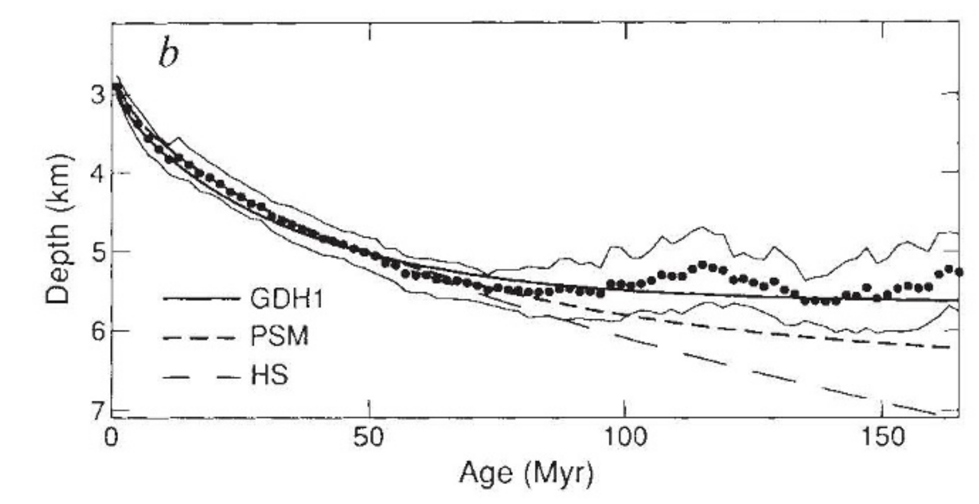
Half-space cooling solutions
Bathymetry: Stein and Stein, 1992
For young seafloor (t < ~100 Ma), works well.
For older seafloor, observations show:
Shallower seafloor

Slide 20
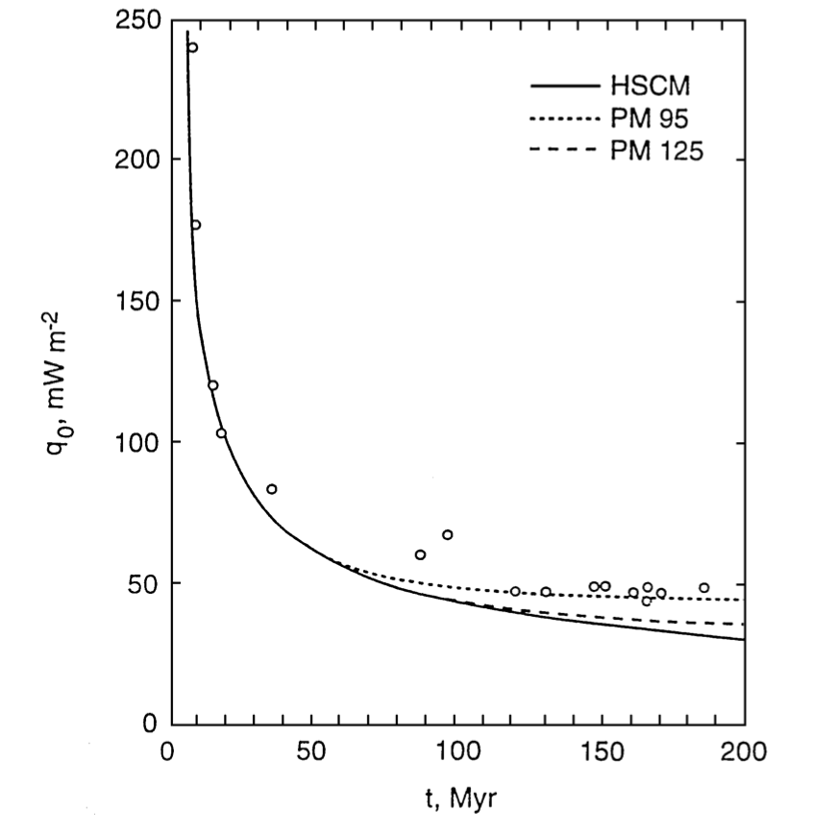
Half-space cooling solutions
Bathymetry: Stein and Stein, 1992
Heat flow: Lister et al., 1990
For young seafloor (t < ~100 Ma), works well.
For older seafloor, observations show:
Shallower seafloor
Higher heat flow

Slide 21
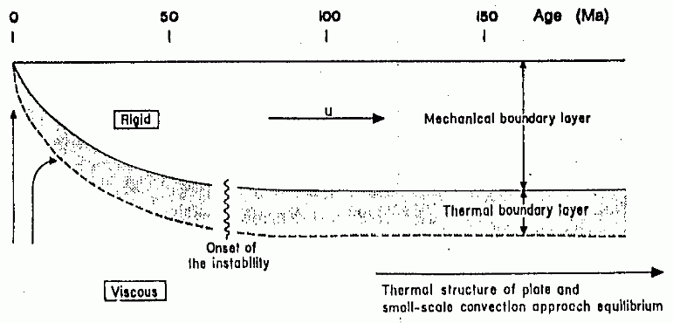
Plate model
Both can be explained by reduced thermal boundary layer thickness for ages > ~ 100 Ma.
Possibly due to onset of small-scale convection, e.g.:
McKenzie and Parsons, 1978
A modified half-space cooling model – plate model – takes this into account by either: adding an additional heat-source or simply limiting the thickness [See T&S, Sect. 4.17].

Slide 22
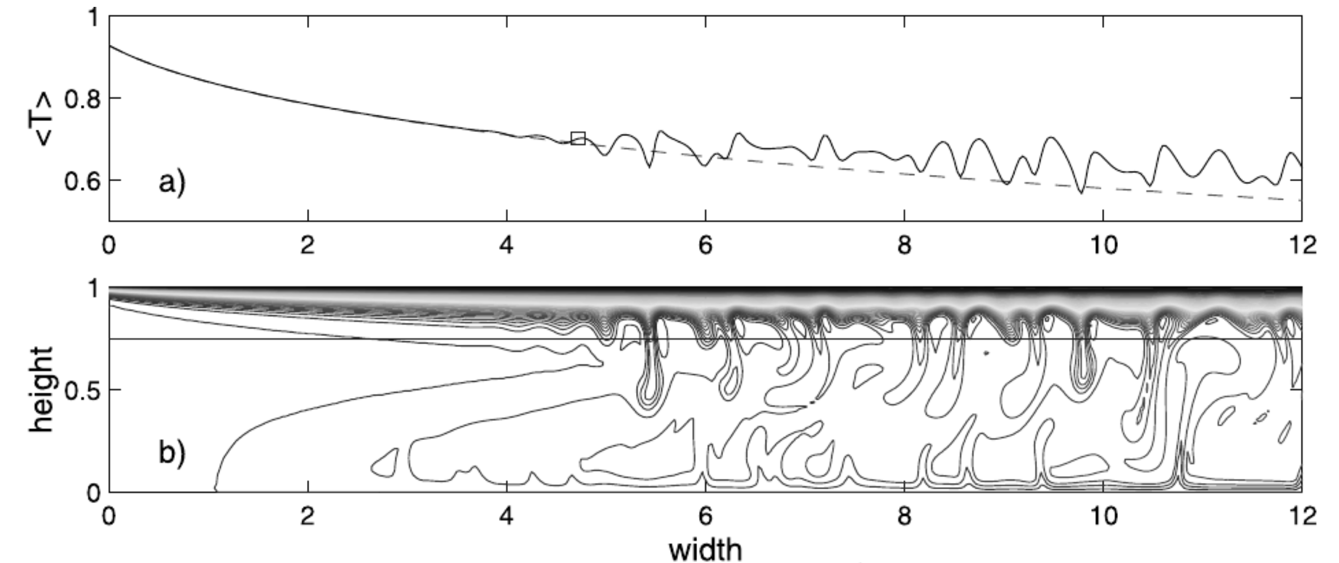
Small scale convection explanation supported by geodynamic modeling
Huang et al., 2003, JGR

Slide 23
Bathymetry: Stein and Stein, 1992
Heat flow: Lister et al., 1990
Plate models (of various types) do improve the fit to data but require more tuning.

Slide 24
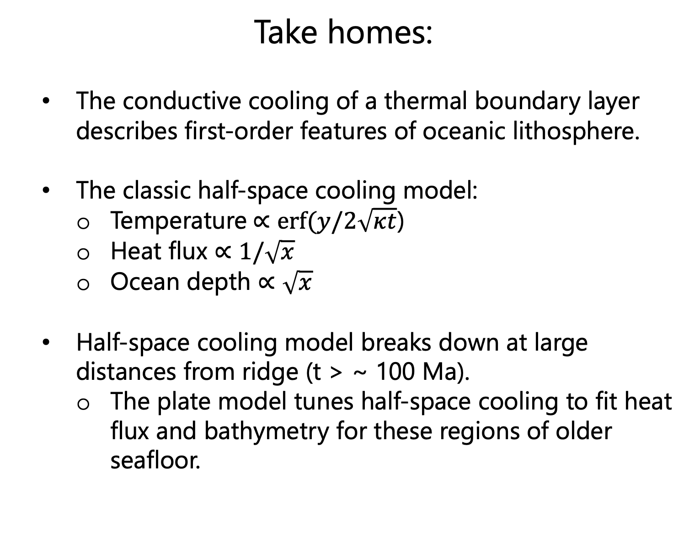
Take homes:
The conductive cooling of a thermal boundary layer describes first-order features of oceanic lithosphere.
The classic half-space cooling model:
Temperature $∝erf⁡(y/2\sqrt{κt}$)
Heat flux $∝1/\sqrt{x}$
Ocean depth $∝\sqrt{x}$
Half-space cooling model breaks down at large distances from ridge (t > ~ 100 Ma).
The plate model tunes half-space cooling to fit heat flux and bathymetry for these regions of older seafloor.

